Slide 1
Wazuh-Splunk Integration Project
Utilizing Splunk Capabilities for SIEM

Slide 2
Problem
There are occurrences in the handling of
network security implementation where the use
of simple monitoring tools can hinder effectiveness.
A network hosting public facing servers or sensitive databases can become vulnerable to well-constructed attacks without tools to detect them. While rsyslog has its strong points in log forwarding and storage, but misses key aspects of log analysis and monitoring system integrity.
This puts more of a workload on log analysis services like Splunk or Elasticsearch, which will receive all data from rsyslog unfiltered. It also puts more strain on indexes and causes analysis to take much longer, since logs are not pre-analyzed or filtered before being sent to Splunk.
Limitations of rsyslog:
Limits amount of files/directories the user can monitor
No built-in threat detection. Cannot analyze logs for threats.
No centralized management options
Lacks log tampering detection and audit
trails. This means rsyslog can’t effectively monitor files essential to system integrity.
This problem affects many SIEM systems in industry, especially regarding networks which were made prior to SIEM implementation. View example of this on next slide.

Slide 3
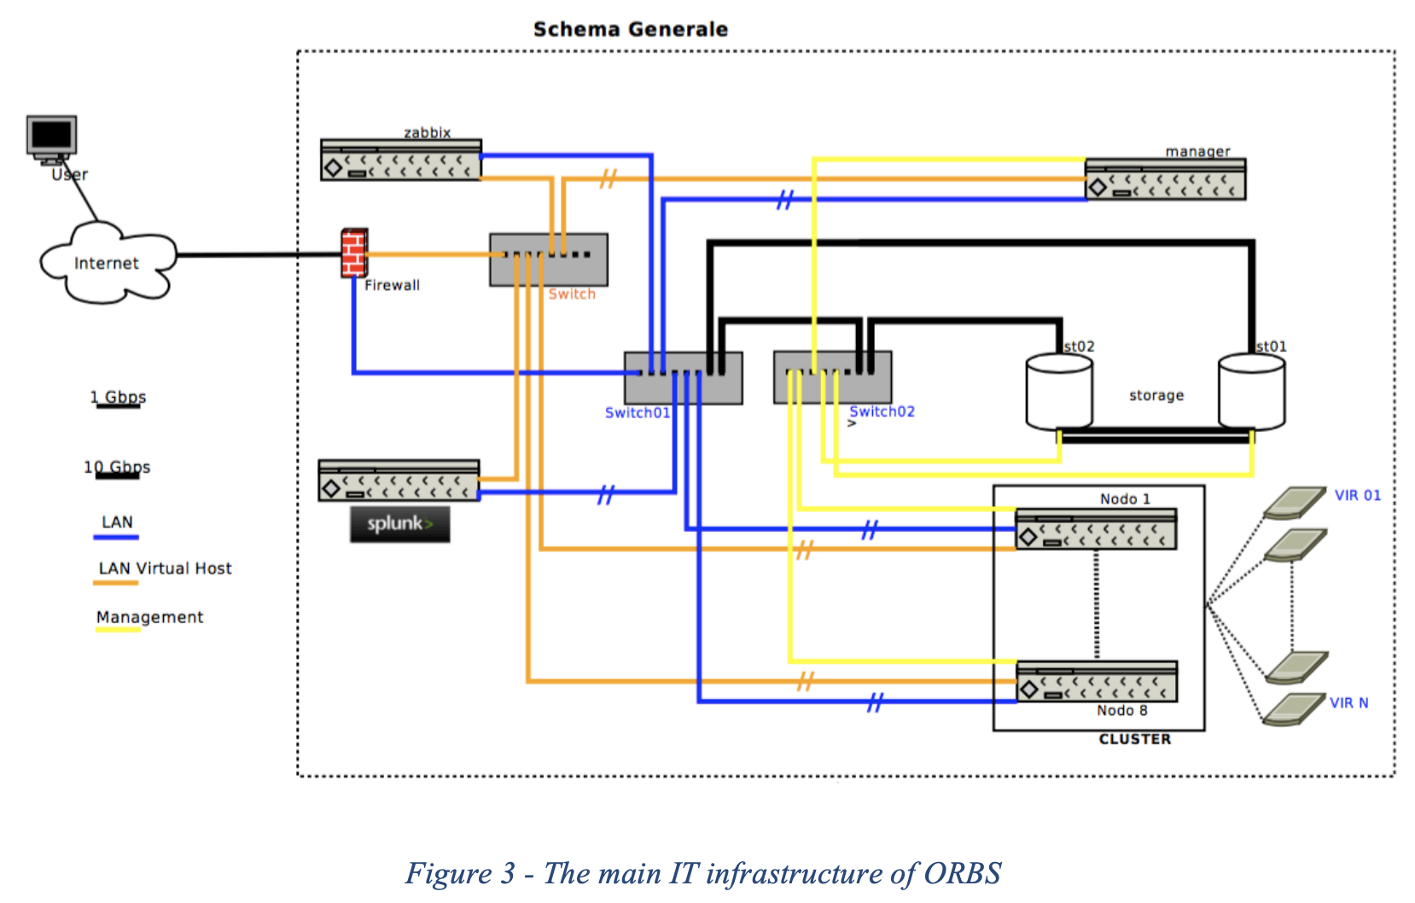
Architecture
The Sicilian Biodiversity Observatory Project (ORBS) utilizes rsyslog and Splunk integration to establish a SIEM system. Zabbix is used to monitor network health and important files. pfSense is the centralized firewall service for all machines on the network. There are two node clusters which host the public facing servers/applications, and two storage servers.

Slide 4
Proposal
Zabbix is used to monitor system health and important files.
Wazuh is an open-source platform which provides security monitoring and protection for IT assets.
By utilizing Wazuh, a centralized security monitoring and threat detection system can monitor all machines in the infrastructure.
This allows for utilization of syslog as well as other security monitoring tools like vulnerability detection and osquery. Wazuh can also monitor sensitive log files and offers threat detection.
Reasoning
Wazuh agents offer more security monitoring tools than rsyslog, while also providing threat detection, whereas Zabbix does not. Wazuh can also replace Zabbix job of monitoring important files.
Why does this make more sense in this architecture?
The network already has Zabbix which monitors health while providing custom scripts and alerts. Having Wazuh monitor for threats and then send them to Splunk offers a similar workflow, but this time handling threat detection.
Notes:
A Wazuh Manager can be used to provide a centralized system to monitor log files and node health. Wazuh Agent’s can be installed on other systems/instances to monitor their files/directories and health.
FIX! - This allows for utilization of syslog as well as other security monitoring tools like vulnerability detection and osquery. Wazuh can also monitor sensitive log files Zabbix monitors, but unlike Zabbix this way offers threat detection.
Zabbix is used to monitor network health and pfSense is the centralized firewall service which controls all of the ingoing and outgoing traffic of all machines on the network. There are node clusters which host the public facing services/web application, and two storage servers.

Slide 5
Project Architecture (Test System with similar infrastructure to ORBS)
Alert Path
Response Path
Virtual Machine: ubuntu-splunk
Splunk Server
Alert Triggered Script
Splunk Forwarder
Virtual Machine: ubuntu-wazuh
Wazuh Manager
Uncomplicated Firewall
Docker
-OWASP Juice Shop
-MySQL Server
Virtual Machine: ubuntu-1
Wazuh Agent
Uncomplicated Firewall (Docker Edition)

Slide 6
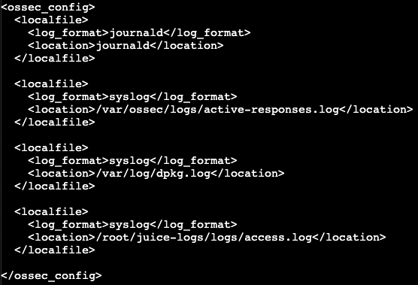
Ubuntu-1 Overview
Wazuh Agent utilizes modules (wodles) such as syscollector and osquery, as well as log analysis and vulnerability detection, to monitor system health and security. (Appendix - 14)
Docker
Docker is equipped with a ufw-docker package to facilitate IP blocking through the docker container
Wazuh Agent Configuration (Code Fragment) :
Docker run command for OWASP Juice Shop
docker run -d -p 3000:3000 \
-v /root/juice-logs/logs:/juice-shop/logs \ --name juice-shop \
--user 0 bkimminich/juice-shop
File Mount
Appendix - 15

Slide 7
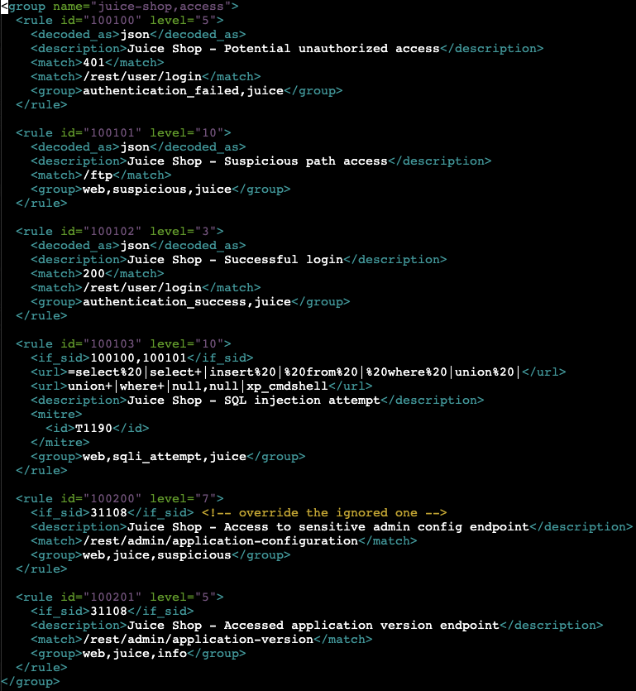
Ubuntu-Wazuh Overview
Wazuh Manager upon download provides many specific rulesets, including the web_rules.xml. This ruleset works in tandem with a custom ruleset I created - 0246-juice-shop_rules.xml
Wazuh Rule Creation
Decoders are a way to parse log data for the purpose of generating alerts from them. URL Matches are specific to web server logs, and allow the user to specify what rule should trigger based on a url fragment. The rule id’s assigned to rules help Splunk understand the threat level as soon as it is sent.
While some rules decode as json within my custom ruleset, the bottom two rules (id=100200, 100201) use a decoder I borrowed from the web_rules.xml ruleset. These default decoders cover a wide range of log formats and exemplify Wazuh’s effectiveness at threat detection.

Slide 8


Ubuntu-Wazuh Continued
Splunk Forwarder:
Software installed on external machine to monitor files/directories and forward to Splunk Index
Splunk Indexes:
Splunk Enterprise offers it’s own indexer to create a repository for data locally
Virtual Indexes allow splunk to source data from external indexes and create a virtual index locally
I/O Configuration
Inputs.conf :
A ‘wazuh-alerts’ index has been created to store all wazuh related logs. The index stores the data locally on the Ubuntu-Splunk virtual machine.
Outputs.conf :

Slide 9
Logging Comparison
Rsyslog
Insecure (unencrypted) log forwarding by default, and manual setup of TLS certificates can be error-prone across systems
No auditing capabilities
No log analysis or threat detection
No log tampering monitoring
Light-weight
Wazuh
Secure TCP log forwarding from agent to manager (Appendix - 16)
Auditing of access and changes to log files (Appendix - 17)
Provides custom decoders and alerts configuration for threat detection
Log normalization and enrichment (Appendix - 17)
Medium-weight (Uses Splunk Forwarder)

Slide 10
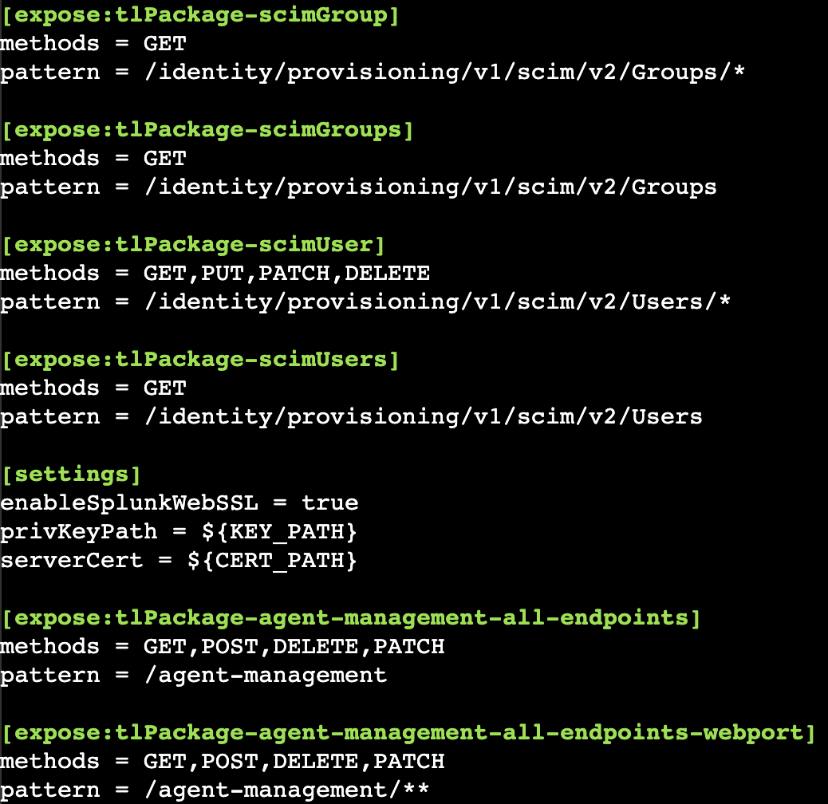
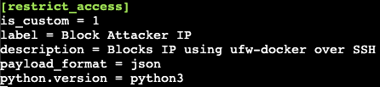
Ubuntu-Splunk Overview
Splunk has been configured with SSL security using a certificate signed by Let’s Encrypt.
$SPLUNK_HOME/etc/system/local/web.conf :
A Splunk App was created to get full customization of alert actions. The app allows users to specify parameters to handle payload conversion and python execution.
$SPLUNK_HOME/apps/juicer/default/alert_actions.conf :

Slide 11
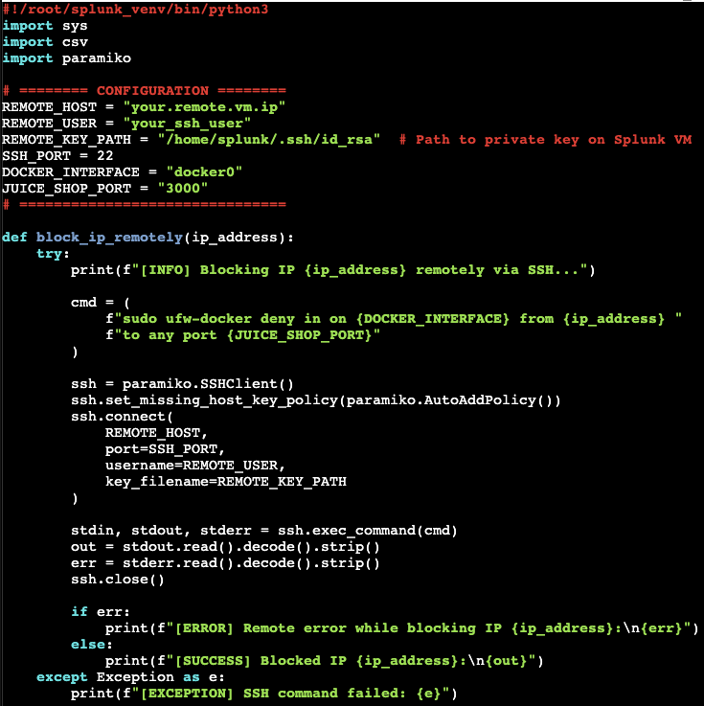
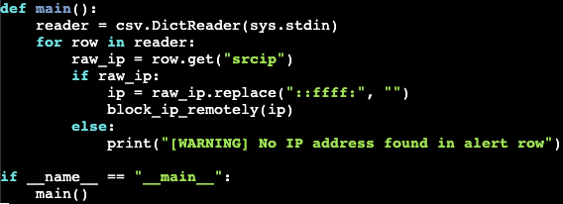
Alerts Breakdown
Python script used to apply for UFW firewall rules to remote virtual machine based off of Splunk Alerts.
$SPLUNK_HOME/bin/etc/apps/juicer/bin/restrict_access.py :
The custom script makes use of the Splunk SDK for python to import paramiko and establish a secure shell.
Paramiko handles the SSH connection to Ubuntu-1 via asymmetric encryption.

Slide 12
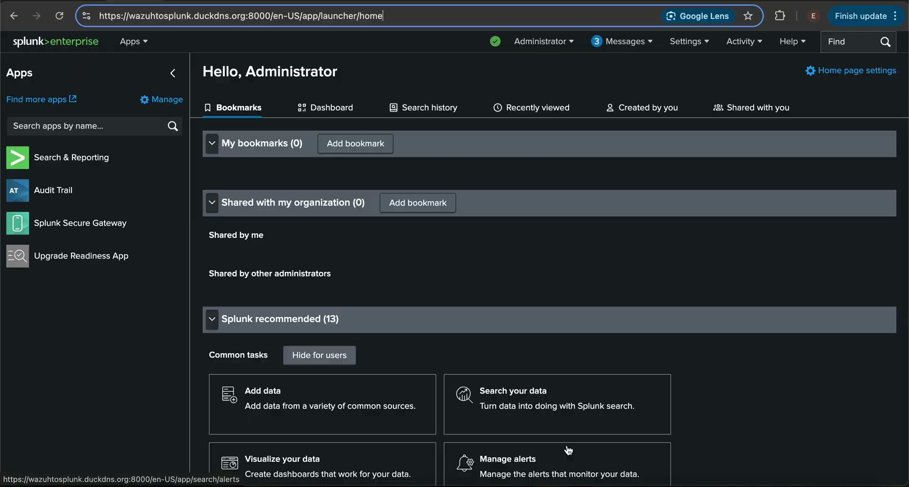

Slide 13
Conclusion
Advantages
Set up alerts from a plethora of log paths
Manage agents through a centralized manager
Install Wazuh modules for specific integrations
The proposed solution presents…
An automated SIEM system
Significant upgrades to security monitoring of network nodes
Customizable threat detection with Wazuh module integrations
Support for tasks covered by Zabbix, while providing similar workflow
Superior management of instances compared to only rsyslog
Disadvantages
Requires more resources than with rsyslog
Requires mediator (Wazuh Manager) to facilitate log transfer. This means the logs must pass through the agent and manager before being sent to Splunk.

Slide 14
Appendix

Slide 15
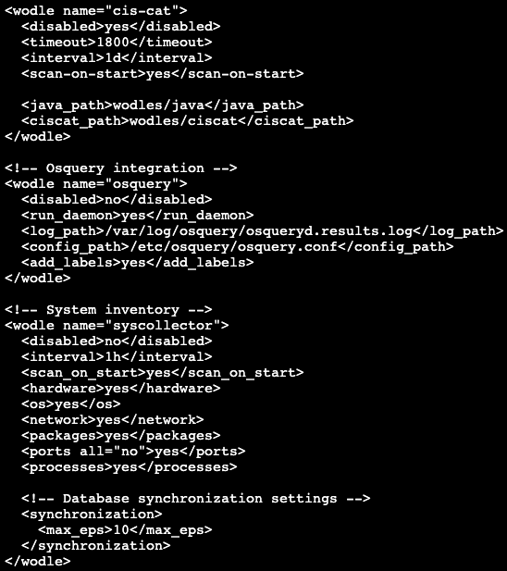
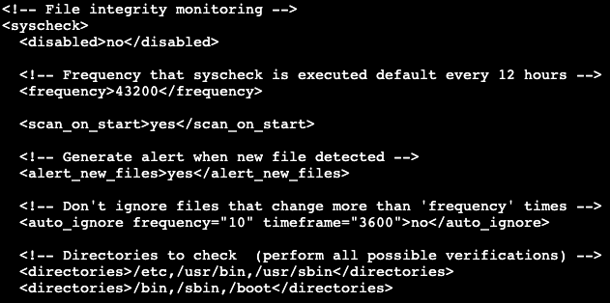
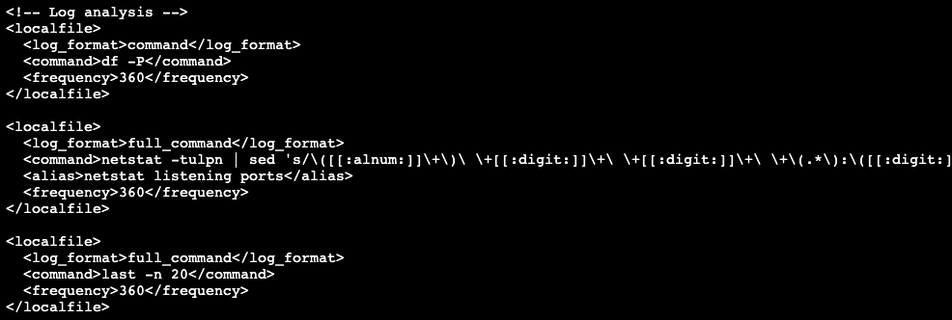
Wazuh Modules (Wodles)

Slide 16
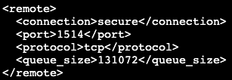
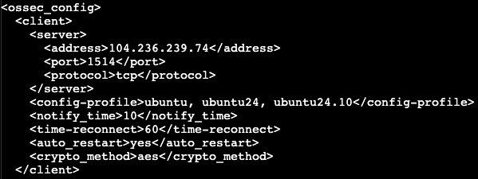
Secure connection through Wazuh
Manager :
File Mounting:
The -v flag is for mounting a volume/file, in this case the Juice Shop logs directory, to a local directory on my machine. This is essential for making logs visible to the Wazuh Agent.
In the context of the ORBS architecture, this would be comparable to setting up an agent on a node within the node cluster. Particularly one running a web server.
Agent :

Slide 17
